Slide 1
OSI Reference model Part 1

Slide 2
What is “protocol”?
Set of rules and operations to make something happen.
May facilitates vendor interoperability. It means new inventions should able to run on multiple vendor devices.
Provides easier troubleshooting.
Different protocols governed by different standard bodies.
IEEE (Institute of electrical and electronic engineering)
IETF (Internet engineering task force)
IANA ( Internet assigned numbers authority)

Slide 3
OSI (open system interconnect) Layers
It is developed by the ISO.
Comprised of 7 layers.
The benefits of using the layered approach are:
Provide easier troubleshooting.
Standardized the network architecture.
Allows vendor interoperability.

Slide 4
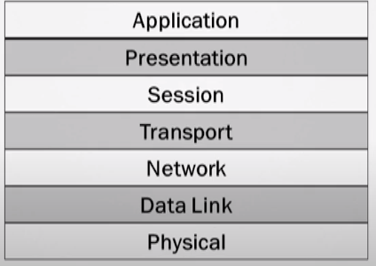
OSI Layers

Slide 5
OSI Layers
Upper Layers: These are rolled into the software package. Applications has packages built into it that will do application layer, presentation layer and session layer work.
Application
Presentation
Session
Lower Layers: CPU will invoke individual programs.
Transport
Network
Data link
Physical

Slide 6
Application Layer
Interacts with the user applications(Firefox, Outlook, etc.)
Provide initial network connection for user applications
Manages the application connections between hosts.

Slide 7
Presentation Layer
Perform encryption within an application.
Ensure the data is presented correctly to the application used.
Perform translation of cross-platform standards that may be understood by the local machine.
Pict. Into .jpg file translation
.wav into .mp3

Slide 8
Session Layer
Helps establish session with reserved port number.
Session identifier is assigned.
Track connections between hosts and remote computers/servers( having multiple tabs opened for same website)

Slide 9
Session Layer
Well-Known ports
Ranges from 0 to 1023
Ports numbers used by well-Known services
Examples: HTTP(80), HTTPS(443), DNS(53), FTP(20,21), TELNET(23), etc.
Registered ports
Reserved for the applications
Ranges from 1024 to 49151
Ephemeral ports(random port number used as source port numbers)
Ranges from 49152 to 65535

